Slide 1
Chapter 12
Processor Structure and Function

Slide 2
Central Processing Unit
CPU architecture, Register organization, Instruction formats and addressing modes(Intel processor).,Basic instruction cycle, Instruction interpretation and sequencing
Control unit, unit Microinstruction, Micro operation, Functioning of micro programmed control unit, RISC and CISC processors, RISC pipelining, RISC and CISC Architecture

Slide 3
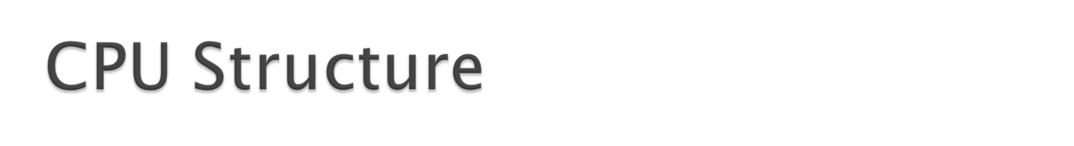
CPU must:
  Fetch instructions
  Interpret instructions
  Fetch data
  Process data
  Write data
Notes:
22

Slide 4
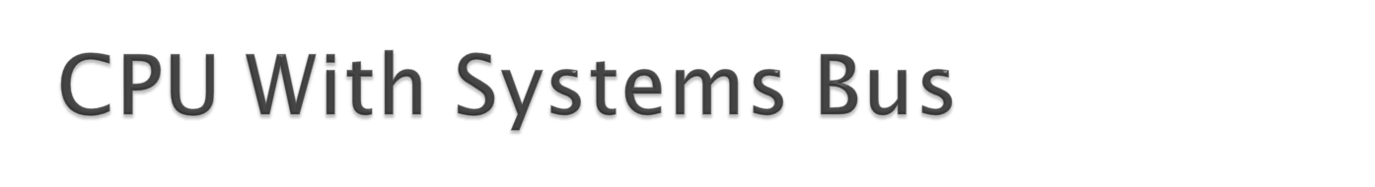
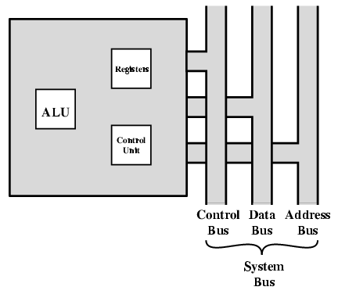

Slide 5
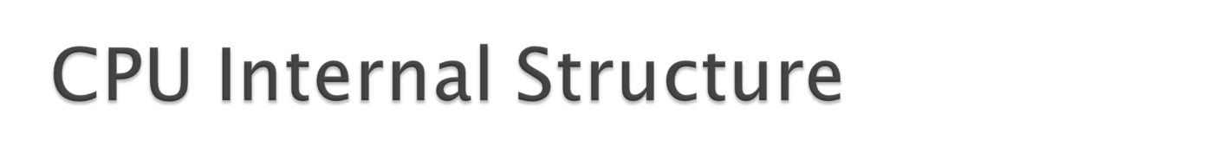
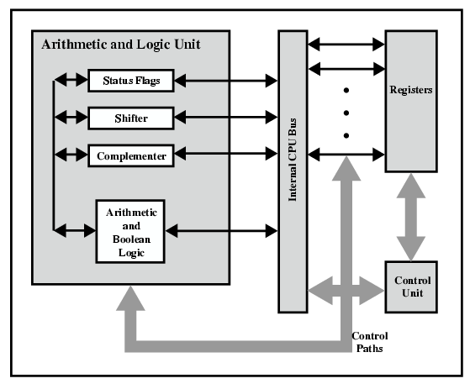

Slide 6
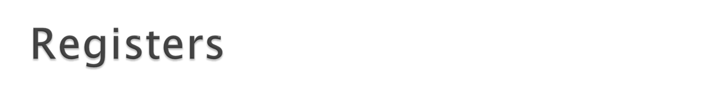
CPU must have some working space (temporary storage)
Called registers
Number and function vary between processor designs
One of the major design decisions
Top level of memory hierarchy
Notes:
23

Slide 7

General Purpose
Data
Address
Condition Codes
Notes:
24

Slide 8



Slide 9


Slide 10

May be true general purpose
May be restricted
May be used for data or addressing
Data
  Accumulator
Addressing
  Segment
Notes:
25

Slide 11

Why make them general purpose?
  Increase flexibility and programmer options
  Increase instruction size & complexity
Make them specialized
  Smaller (faster) instructions
  Less flexibility
Notes:
26

Slide 12

Large enough to hold full address
Large enough to hold full word
Often possible to combine two data registers
  C programming
  double int a;
  long int a;
Notes:
28

Slide 13

Sets of individual bits
  e.g. result of last operation was zero
Can be read (implicitly) by programs
  e.g. Jump if zero
Can not (usually) be set by programs
Notes:
29

Slide 14

Program Counter (PC)
Instruction Decoding Register(IR)
Memory Address Register(MAR)
Memory Buffer Register(MBR)
Notes:
30

Slide 15

A set of bits
Includes Condition Codes
Sign of last result
Zero
Carry
Equal
Overflow
Interrupt enable/disable
Supervisor
Notes:
31

Slide 16

AX is the primary accumulator; it is used in input/output and most arithmetic instructions. For example, in multiplication operation, one operand is stored in EAX or AX or AL register according to the size of the operand.
BX is known as the base register, as it could be used in indexed addressing.
CX is known as the count register, as the ECX, CX registers store the loop count in iterative operations.
DX is known as the data register. It is also used in input/output operations. It is also used with AX register along with DX for multiply and divide operations involving large values.

Slide 17

Instruction Pointer (IP) − The 16-bit IP register stores the offset address of the next instruction to be executed. IP in association with the CS register (as CS:IP) gives the complete address of the current instruction in the code segment.
Stack Pointer (SP) − The 16-bit SP register provides the offset value within the program stack. SP in association with the SS register (SS:SP) refers to be current position of data or address within the program stack.
Base Pointer (BP) − The 16-bit BP register mainly helps in referencing the parameter variables passed to a subroutine. The address in SS register is combined with the offset in BP to get the location of the parameter. BP can also be combined with DI and SI as base register for special addressing.

Slide 18

SI and DI, are used for indexed addressing and sometimes used in addition and subtraction.
There are two sets of index pointers −
Source Index (SI) − It is used as source index for string operations.
Destination Index (DI) − It is used as destination index for string operations.

Slide 19
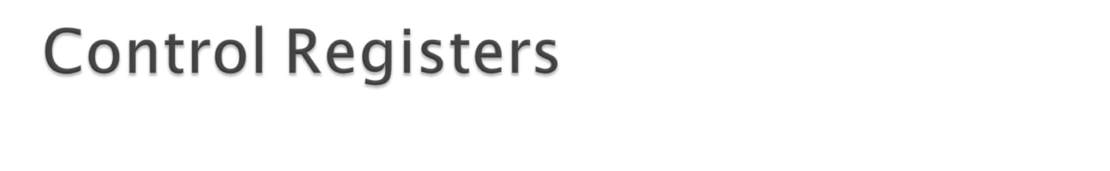
The 32-bit instruction pointer register and the 32-bit flags register combined are considered as the control registers.
Many instructions involve comparisons and mathematical calculations and change the status of the flags and some other conditional instructions test the value of these status flags to take the control flow to other location.
The common flag bits are:

Slide 20
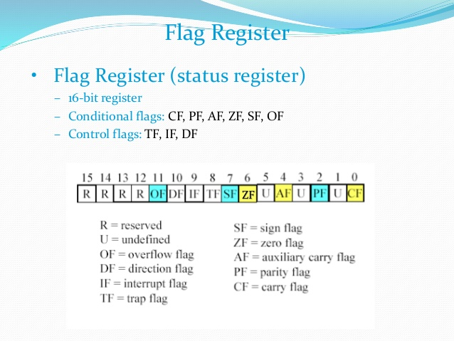

Slide 21
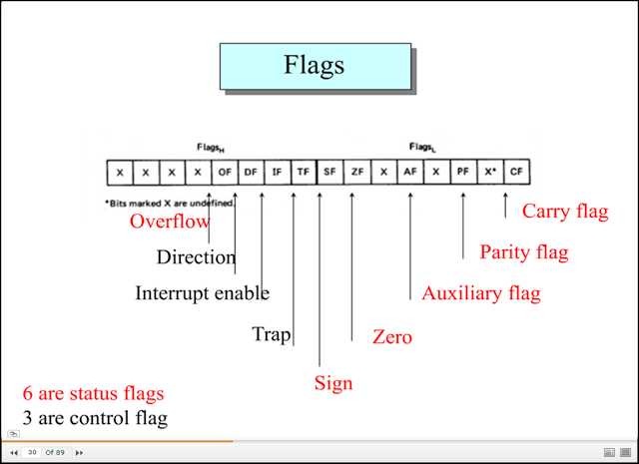

Slide 22
Overflow Flag (OF) − It indicates the overflow of a high-order bit (leftmost bit) of data after a signed arithmetic operation.
Direction Flag (DF) − It determines left or right direction for moving or comparing string data. When the DF value is 0, the string operation takes left-to-right direction and when the value is set to 1, the string operation takes right-to-left direction.

Slide 23
Trap Flag (TF) − It allows setting the operation of the processor in single-step mode. The DEBUG program we used sets the trap flag, so we could step through the execution one instruction at a time.
Sign Flag (SF) − It shows the sign of the result of an arithmetic operation. This flag is set according to the sign of a data item following the arithmetic operation. The sign is indicated by the high-order of leftmost bit. A positive result clears the value of SF to 0 and negative result sets it to 1.
Zero Flag (ZF) − It indicates the result of an arithmetic or comparison operation. A nonzero result clears the zero flag to 0, and a zero result sets it to 1.

Slide 24
Interrupt Flag (IF) − It determines whether the external interrupts like keyboard entry, etc., are to be ignored or processed. It disables the external interrupt when the value is 0 and enables interrupts when set to 1.

Slide 25
Auxiliary Carry Flag (AF) − It contains the carry from bit 3 to bit 4 following an arithmetic operation; used for specialized arithmetic. The AF is set when a 1-byte arithmetic operation causes a carry from bit 3 into bit 4.
Parity Flag (PF) − It indicates the total number of 1-bits in the result obtained from an arithmetic operation. An even number of 1-bits clears the parity flag to 0 and an odd number of 1-bits sets the parity flag to 1.
Carry Flag (CF) − It contains the carry of 0 or 1 from a high-order bit (leftmost) after an arithmetic operation. It also stores the contents of last bit of a shift or rotate operation.

Slide 26

Segments are specific areas defined in a program for containing data, code and stack. There are three main segments −
Code Segment − It contains all the instructions to be executed. A 16-bit Code Segment register or CS register stores the starting address of the code segment.
Data Segment(DS,ES) − It contains data, constants and work areas. A 16-bit Data Segment register or DS register stores the starting address of the data segment.
Stack Segment − It contains data and return addresses of procedures or subroutines. It is implemented as a 'stack' data structure. The Stack Segment register or SS register stores the starting address of the stack.

Slide 27

Notes:
35

Slide 28


Two steps:
  Fetch
  Execute

Slide 29
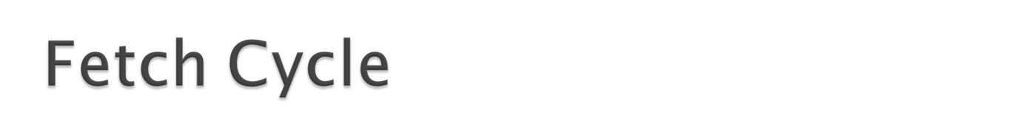
Program Counter (PC) holds address of next instruction to fetch
Processor fetches instruction from memory location pointed to by PC
Increment PC
  Unless told otherwise
Instruction loaded into Instruction Register (IR)
Processor interprets instruction and performs required actions

Slide 30

Processor-memory
  data transfer between CPU and main memory
Processor I/O
  Data transfer between CPU and I/O module
Data processing
  Some arithmetic or logical operation on data
Control
  Alteration of sequence of operations
  e.g. jump
Combination of above

Slide 31

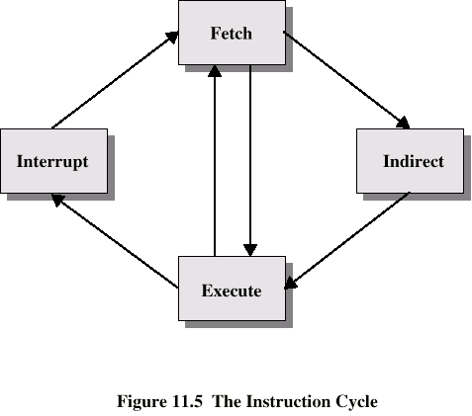

Slide 32

Depends on CPU design
In general:
Fetch
  PC contains address of next instruction
  Address moved to MAR
  Address placed on address bus
  Control unit requests memory read
  Result placed on data bus, copied to MBR, then to IR
  Meanwhile PC incremented by 1

Slide 33

May take many forms
Depends on instruction being executed
May include
  Memory read/write
  Input/Output
  Register transfers
  ALU operations

Slide 34

Simple
Predictable
Current PC saved to allow resumption after interrupt
Contents of PC copied to MBR
Special memory location (e.g. stack pointer) loaded to MAR
MBR written to memory
PC loaded with address of interrupt handling routine
Next instruction (first of interrupt handler) can be fetched

Slide 35

May require memory access to fetch operands
Indirect addressing requires more memory accesses
Can be thought of as additional instruction subcycle

Slide 36

Mechanism by which other modules (e.g. I/O) may interrupt normal sequence of processing
Program
  e.g. overflow, division by zero
Timer
  Generated by internal processor timer
  Used in pre-emptive multi-tasking
I/O
  from I/O controller
Hardware failure
  e.g. memory parity error

Slide 37

Added to instruction cycle
Processor checks for interrupt
  Indicated by an interrupt signal
If no interrupt, fetch next instruction
If interrupt pending:
  Suspend execution of current program
  Save context
  Set PC to start address of interrupt handler routine
  Process interrupt
  Restore context and continue interrupted program

Slide 38



Slide 39



